Slide 1

Welcome to the
NM Medical Board
2025 Renewal Tutorial
www.nmmb.state.nm.us

Slide 2
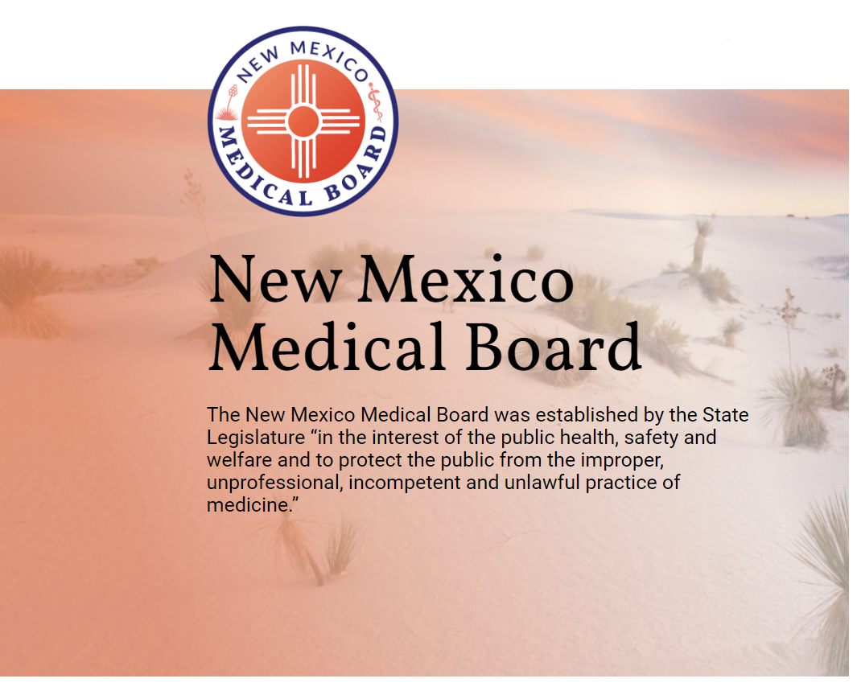
Renewing your License
Welcome!
We’re here to help you renew your license.
Creating your Provider Portal
Renewing your License
Documents Needed
Checking the Status
Accessing your Renewed License Certificate

Slide 3
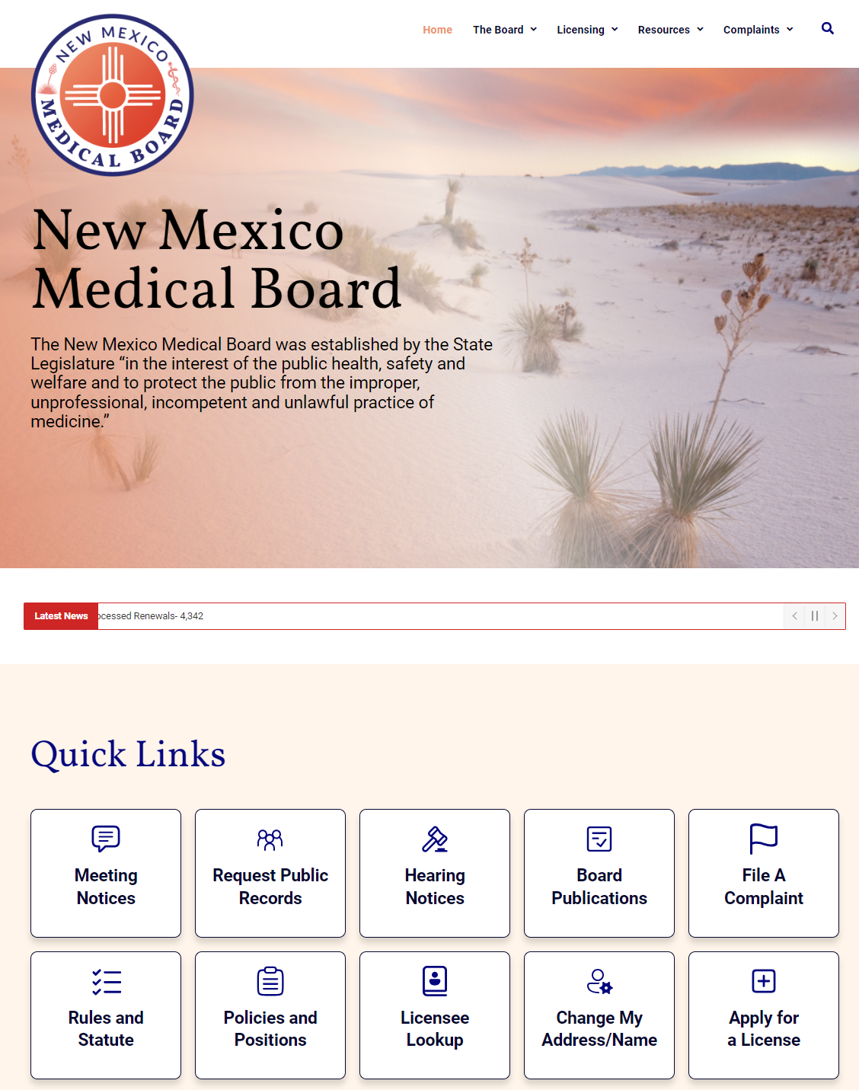
Creating your Provider Portal
Where to start:
1
Go to the New Mexico Medical Board website at www.nmmb.state.nm.us
2
Scroll down and select the Quick Link for “Apply for a License”

Slide 4
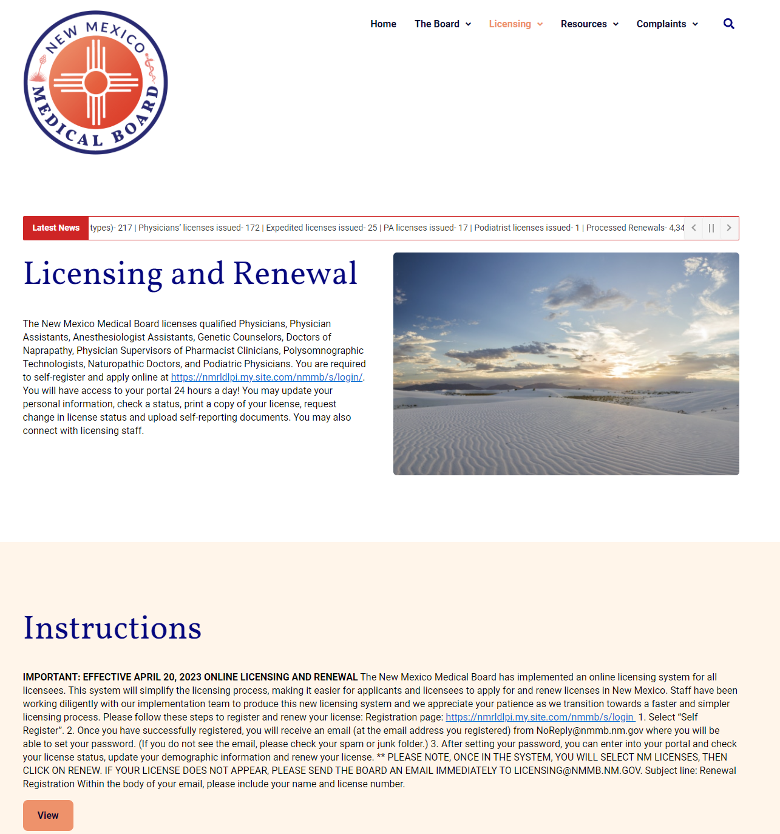
Creating your Provider Portal
Where to start:
1
Go to the New Mexico Medical Board website at www.nmmb.state.nm.us
2
Scroll down and select the Quick Link for “Apply for a License”
3
Click on the link to the Provider Portal Login page

Slide 5
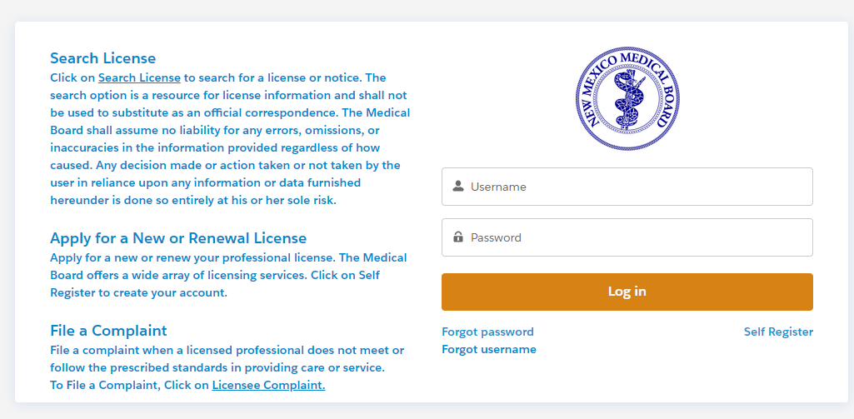
Creating your Provider Portal
Where to start:
1
Go to the New Mexico Medical Board website at www.nmmb.state.nm.us
2
Scroll down and select the Quick Link for “Apply for a License”
3
Click on the link to the Provider Portal Login page
4
Click on “Self Register” and complete the form.

Slide 6
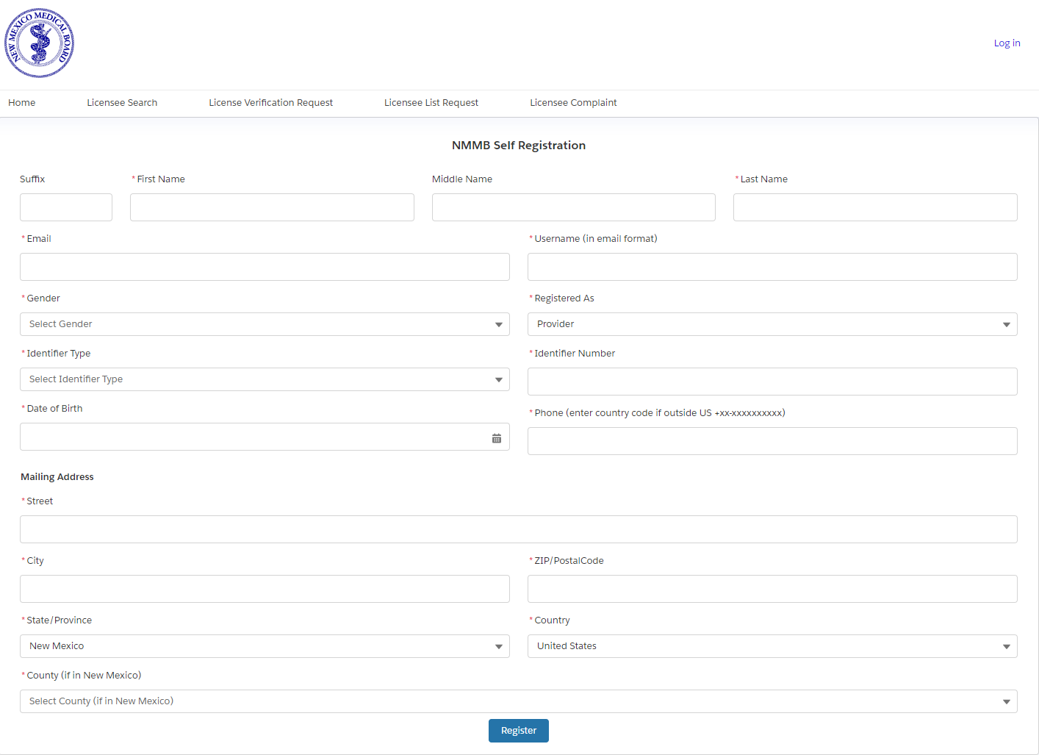
Creating your Provider Portal
Where to start:
1
Go to the New Mexico Medical Board website at www.nmmb.state.nm.us
2
Scroll down and select the Quick Link for “Apply for a License”
3
Click on the link to the Provider Portal Login page
4
Click on “Self Register” and complete the form.
5
Check your email and look for an email from noreply@salesforce.com
If you receive an error message stating that your username is already in use, this is because you are using that email address as your username with another agency.
The username has to be in an email format but does not have to be a real email address.
Example:
  provider@gmail.com
  provider.nmmb@gmail.com

Slide 7
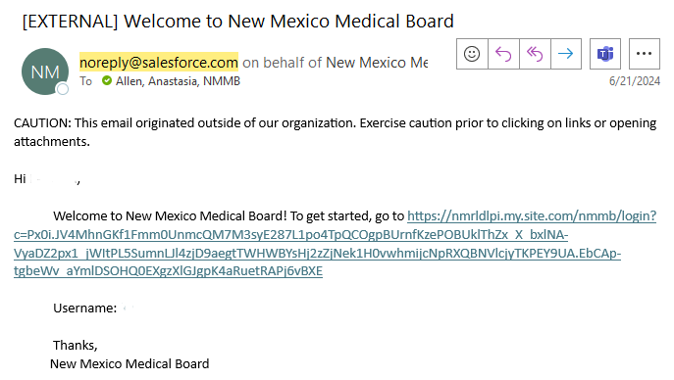
Creating your Provider Portal
Where to start:
1
Go to the New Mexico Medical Board website at www.nmmb.state.nm.us
2
Scroll down and select the Quick Link for “Apply for a License”
3
Click on the link to the Provider Portal Login page
4
Click on “Self Register” and complete the form.
5
Check your email and look for an email from noreply@salesforce.com

Slide 8
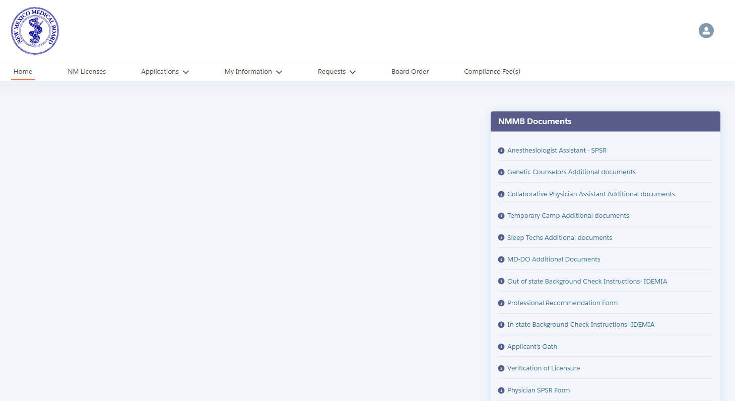
Renewing your License
Once you have logged into your provider portal:
1
Select the “NM Licenses” tab at the top of the page

Slide 9
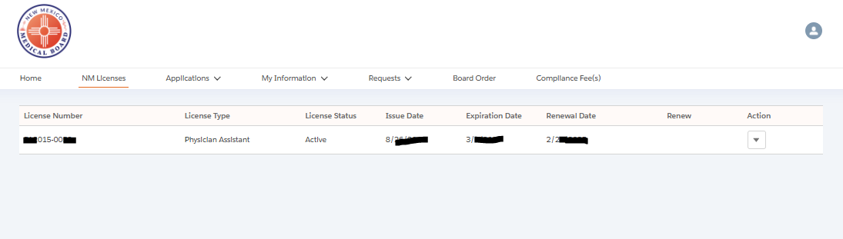
Renewing your License
Once you have logged into your provider portal:
1
Select the “NM Licenses” tab at the top of the page
2
You should see you license information with a “Renew” link to the right.
Renew

Slide 10
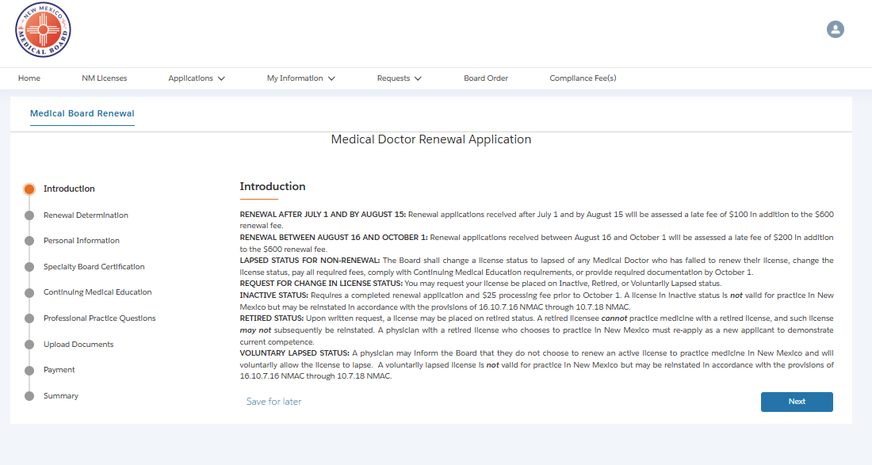
Completing the Renewal
Introduction Page:
1
This is an introduction and welcome message with helpful information and expectations as you move the renewal process.

Slide 11
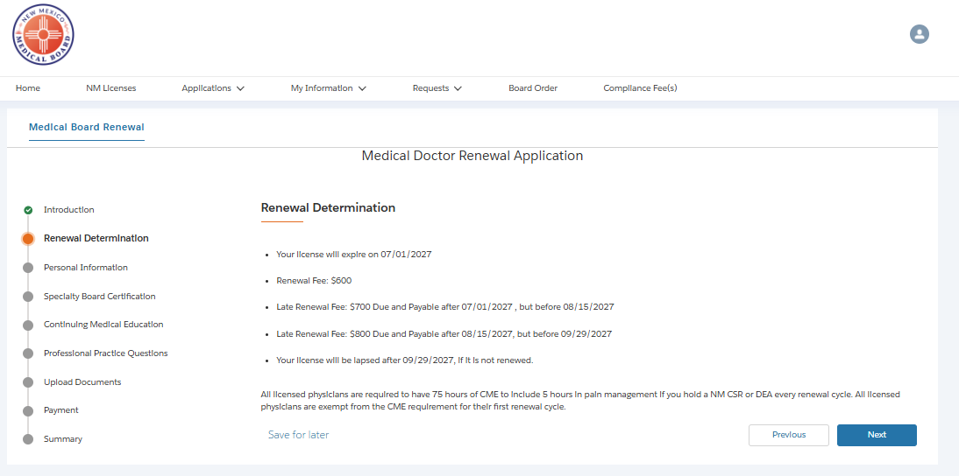
Completing the Renewal
Renewal Determination
1
This describes the fees and other important information .

Slide 12
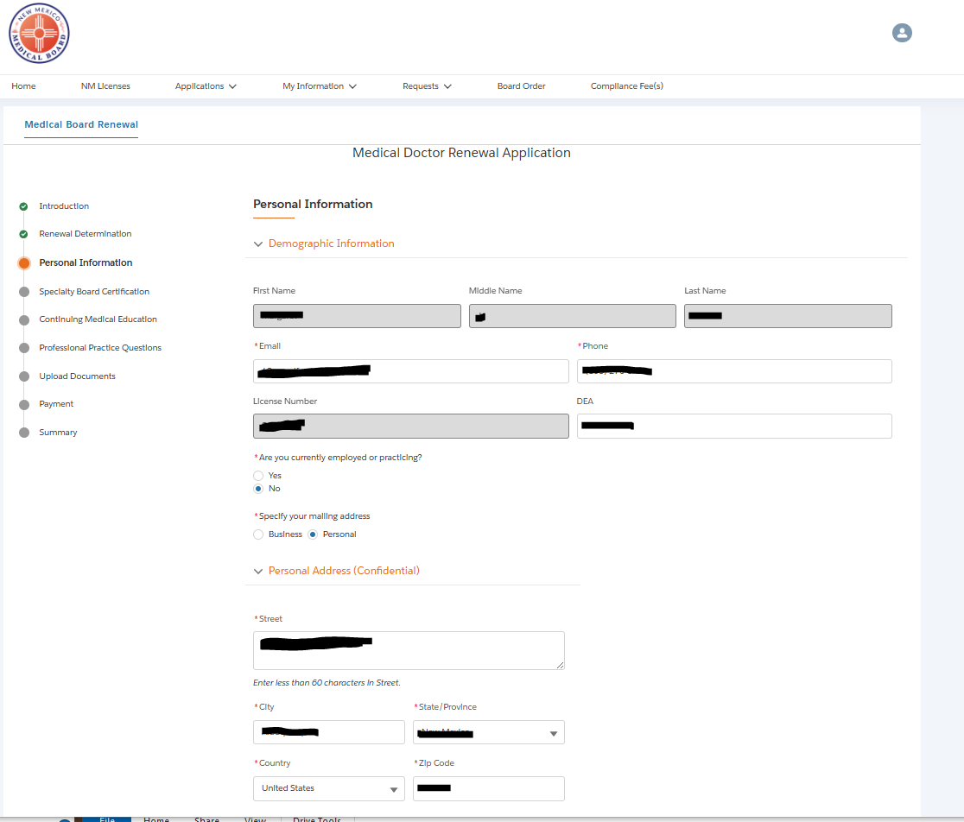
Completing the Renewal
Personal Information
1
Complete all fields that have red *
2
Gray fields are information you already entered during your registration and cannot be changed here.
3
Please make sure to enter your addresses correctly and select which address you want to receive correspondence to.

Slide 13
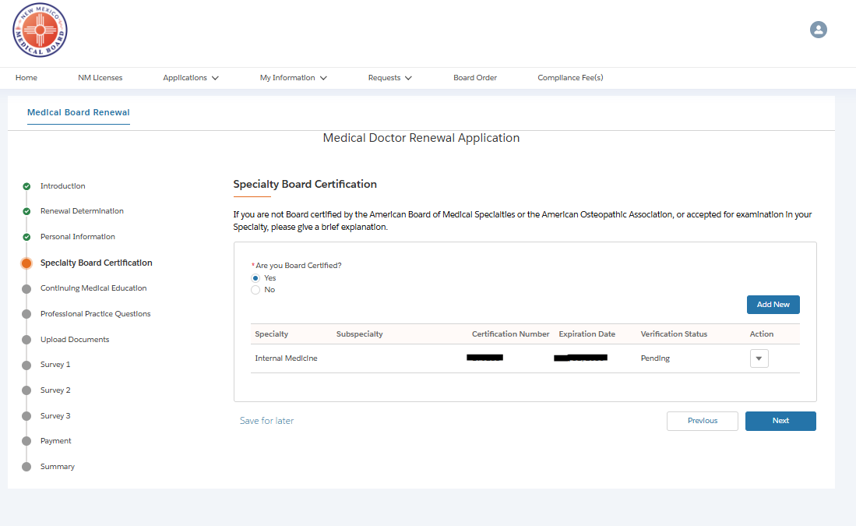
Completing the Renewal
Specialty Board Certification
1
Click on “Add New” to enter and select your Specialty Information.

Slide 14
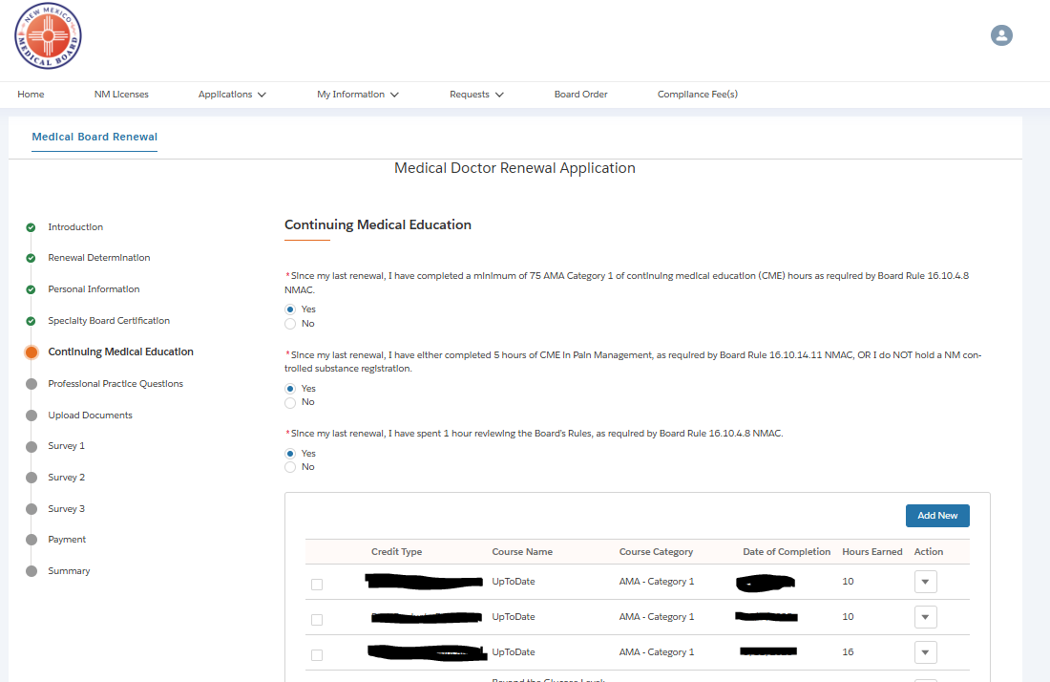
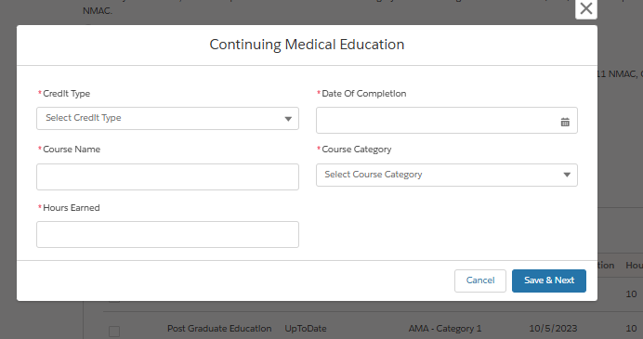
Completing the Renewal
Continuing Medical Education
1
Answer all questions and click “Add New” to enter your CME information.
The New Mexico Medical Board requires 75 hours of CME to include 5 hours in pain management (if you hold a NM CSR or DEA) each renewal cycle. The audit will randomly select 10 percent from the licensees that renew this cycle. The New Mexico Medical Board utilizes CE broker to complete our CME audit every year. If you are selected, you will receive an email/letter from CE Broker in September of 2025.

Slide 15
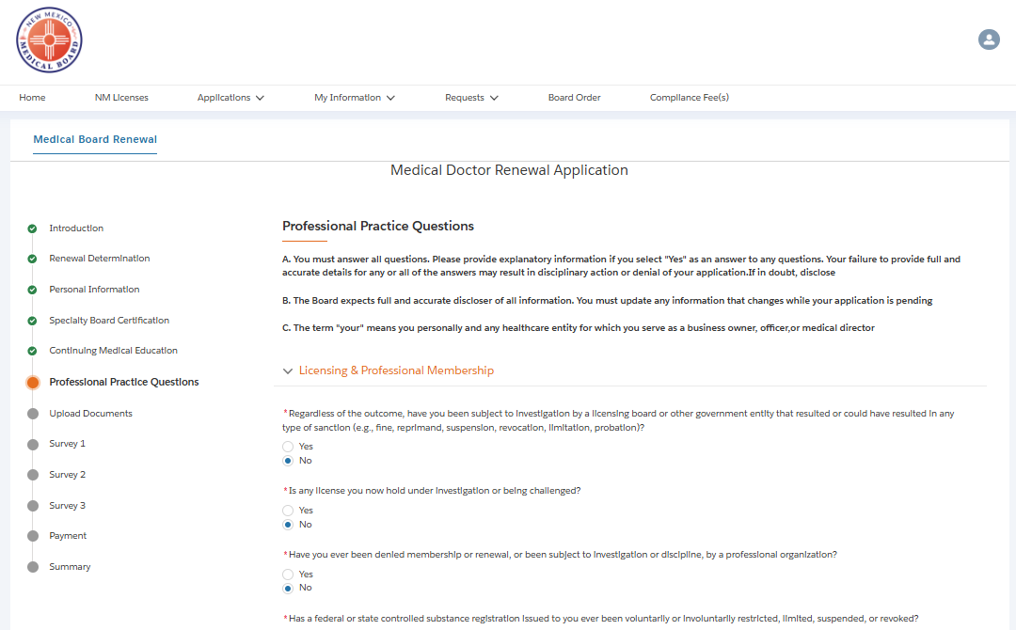
Completing the Renewal
Professional Practice Questions
1
Read each questions carefully and answer accordingly. Please note, some questions may have changed since your last renewal.
2
If additional information is needed regarding a questions, a text box will appear for you to provide additional information.
3
You may have to upload additional documents later in the renewal. If there are incidents that you have already reported to the Board, please state that it has previously been reported to the Board.

Slide 16
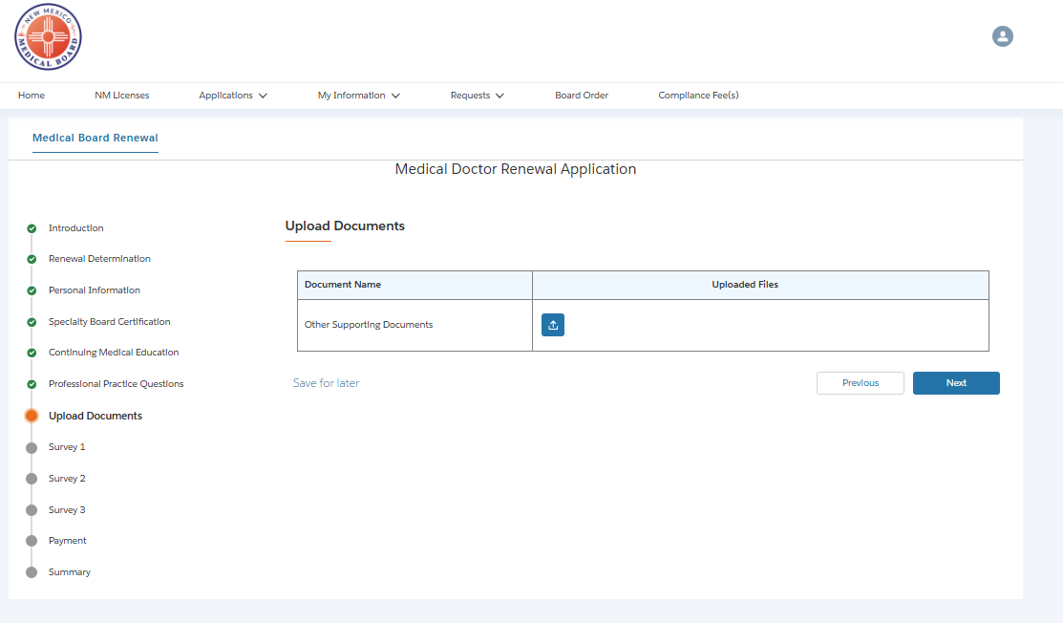
Completing the Renewal
Upload Documents
1
Please upload any additional documentation here.
Court Documents
CME’s
Any other documents.

Slide 17
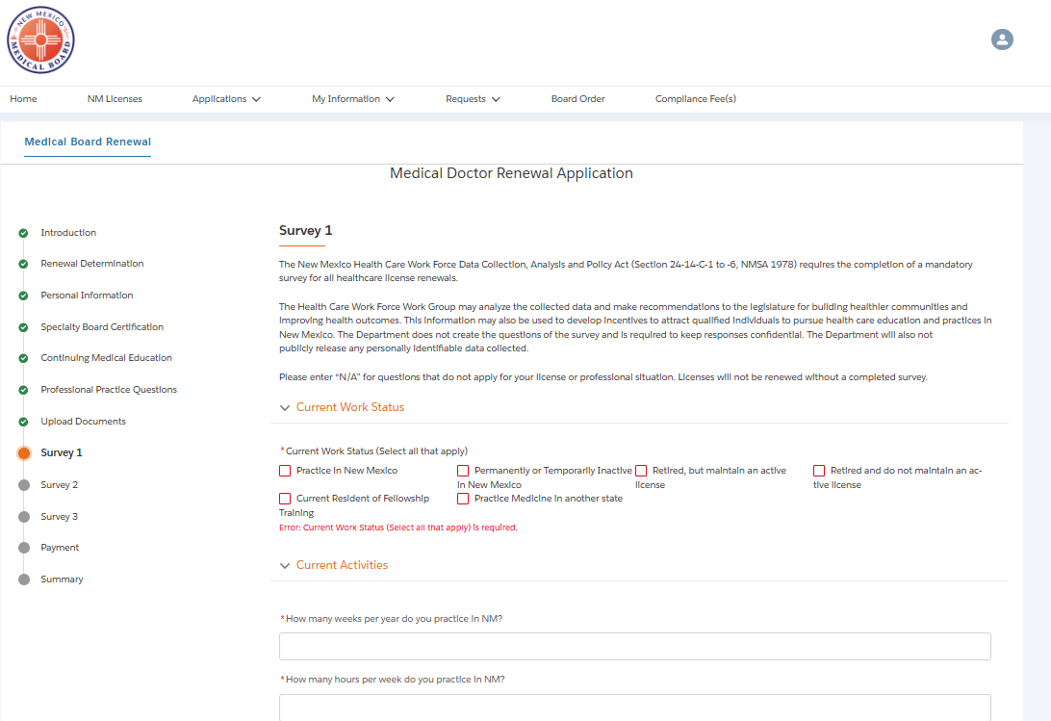
Completing the Renewal
Survey
1
The survey is for providers that are currently practicing in New Mexico.
There are 3 pages of survey questions. Please answer all questions to the best of your ability.
All questions needing percentages, require all fields to have an answer, even if it is “0”.

Slide 18
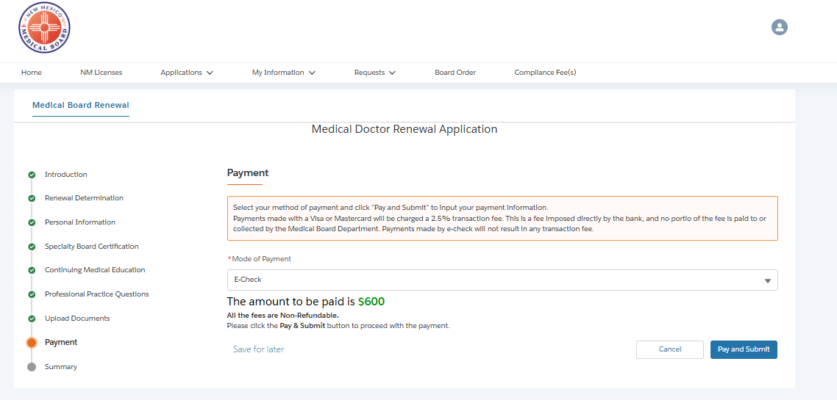


Completing the Renewal
Payment
1
Here you will select your method of payment. You can choose Credit/Debit or E-Check.
(You will enter the specific payment information in the following screens.)

Slide 19
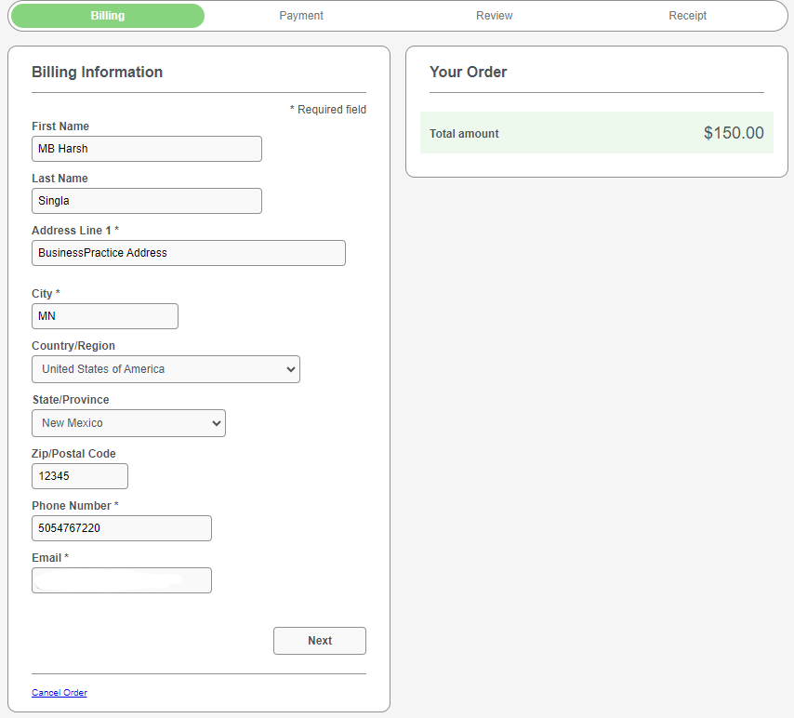


Completing the Renewal
Payment
1
Here you will select your method of payment. You can choose Credit/Debit or E-Check.
(You will enter the specific payment information in the following screens.)

Slide 20
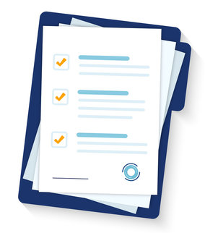
Completing the Renewal
Once you have submitted your payment, there will be a message letting you know if your payment and renewal have been received successfully. If will also let you know if your license has been renewed.
1
Download your renewed license certificate.
2
Email the Board for an itemized receipt for reimbursement.
3
Certificates will be mailed automatically.

Slide 21
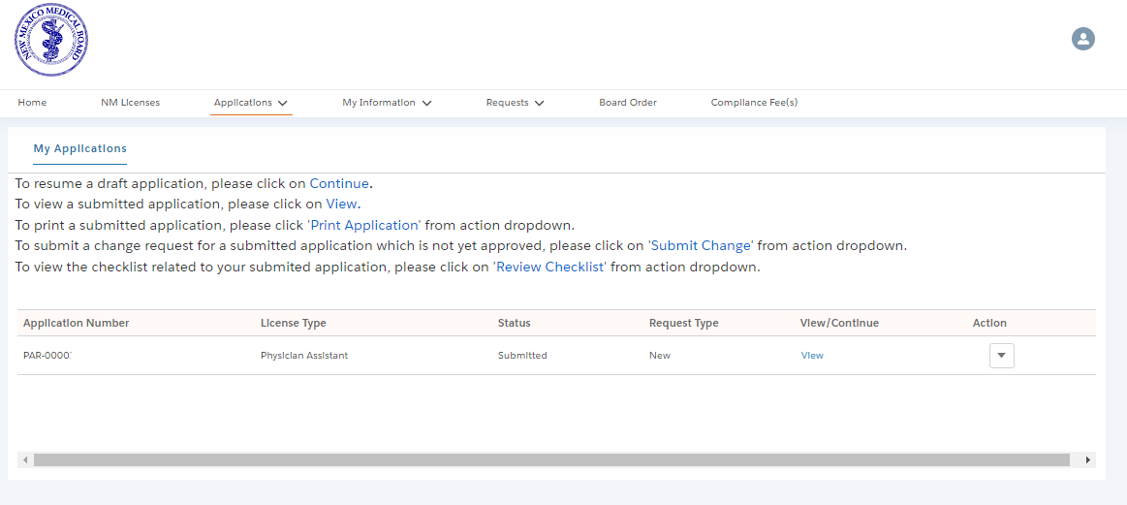

What comes next?
Now that you have submitted your renewal, you can expect :
Checking your Status
Review and Issuance
License certificate will be mailed.
Anyone selected for the audit will be notified individually.
Email the Board to request an itemized receipt at
nm.medicalboard@nmmb.nm.gov
You can print a PDF copy of your renewed license by clicking the “Action” box next to your license information and choose “Download”.
If your license isn’t renewed right away, it should be renewed within 5 business days.
You should expect the certificate in the mail within a week or two.

Slide 22

Have more questions?
If you ever have questions, reach out. We are happy to help.
Medical Board Web Site
Provider Portal Login
Rules and Statutes
nm.medicalboard@nmmb.nm.gov

